Slide 1


Optimizing Semiconductor Manufacturing Process using Bayesian Optimization Techniques Presented by Varad Lad (ASU ID -1226212769 ) Shubham Jadhav (ASU ID -1226315950 ) Submitted to Dr. Houlong Zhuang MAE 551

Slide 2
Introduction
Semiconductor Industry Pursuit of Process Enhancement
Application of Bayesian Optimization in Semiconductor Deposition Rate
Python Code Demonstration for Deposition Rate Optimization

Slide 3

Literature Review
Evolution of Semiconductor Industry and Optimization Focus
Bayesian Optimization in Semiconductor Fabrication
Case Studies: Bayesian Optimization vs. Traditional Methods

Slide 4
Background
Significance of Deposition Rate in Semiconductor Quality
Example of Bayesian Optimization in Semiconductor Material
Bayesian Optimization Workflow for Deposition Rate Maximization

Slide 5
Methodology
Methodology Overview - Bayesian Optimization in Study
Steps in Bayesian Optimization Process
Application to Semiconductor Material - Design Space and Python Code

Slide 6

Steps in Bayesian Optimization Process
Initialize the GP model.
Objective function at a randomly selected point in the design space.
GP model using the new data point.
Optimal solution based on the GP model's insights.
Objective function at the predicted optimal solution.

Slide 7
Workflow
Initialization
Beginning of Bayesian Optimization
Goal to optimize Temp with range 100 to 500 °C and Power with the Range of 50 to 150 W.
Optimization
The algorithm operates in an iterative fashion, proposing new sets of parameters for evaluation based on past performance.
This iterative cycle continues for a specified number of iterations.

Slide 8
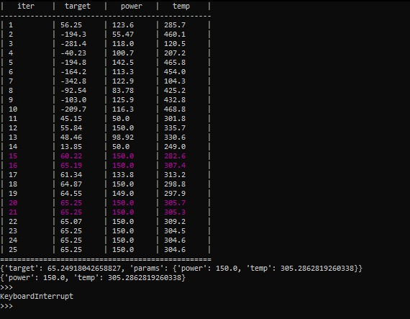
Result
Optimized Deposition Rate and Parameters
Consistency with Previous Studies
Significance of Improvement and Potential Enhancements

Slide 9

Conclusion
Practical Solution for Semiconductor Deposition Optimization
Bayesian Optimization Framework and Open-Source Python Code
Case Study Results and Significance

